Slide 1

2024 Shepherds 360 National Conference
Building
Better Sermons

Slide 2
2024 Shepherds 360 National Conference
Structuring for
Clarity & Purpose

Slide 3
Some professions
(engineering,
accounting,
medicine, teaching)
require continuing education
to maintain your certification.
WHY?

Slide 4
Some professions
(engineering,
accounting,
medicine, teaching)
require continuing education
to maintain your certification.
AN ATTEMPT TO GUARANTEE
IMPROVEMENT IN SKILLS

Slide 5
To improve means you
intentionally seek to assess
your weaknesses…
and correct them

Slide 6
“he who hates correction is
stupid” (Proverbs 12:1)

Slide 7
Sharpening
Ministry Skills:
PREACHING

Slide 8

HINDRANCES TO IMPROVEMENT

Slide 9

PERSPICUITY & PREACHING

Slide 10
Perspicare: Latin for “transparent” clear, lucid, understandable

Slide 11








Perspicuity means “clarity, something is clear.”

Slide 12
The doctrine of perspicuity means that the central message of the Bible is clear and understandable.
“. . . the testimony of the Lord is sure, making wise the simple.” (Psalm 19:7)

Slide 13
PERSPICUITY AND PREACHING
The Bible is clear and understandable… so should your sermons be clear and understandable.
The average listener should be able to perceive how your sermon is structured, with clear order and arrangement, always pointing back to and explaining the biblical text.
Your prayer should be that your sermons always reflect the perspicuity of Scripture.

Slide 14
PERSPICUITY AND PREACHING
The Bible is clear and understandable… so should your sermons be clear and understandable.
The average listener should be able to perceive how your sermon is structured, with clear order and arrangement, always pointing back to and explaining the biblical text.
Your prayer should be that your sermons always reflect the perspicuity of Scripture.

Slide 15
PERSPICUITY AND PREACHING
The Bible is clear and understandable… so should your sermons be clear and understandable.
The average listener should be able to perceive how your sermon is structured, with clear order and arrangement, always pointing back to and explaining the biblical text.
Your prayer should be that your sermons always reflect the perspicuity of Scripture.

Slide 16

T. David Gordon
Why Johnny Can’t Preach
I would guess that of the sermons I’ve heard in the last twenty-five years, 15 percent had a discernible point; I could say, “The sermon was about X.”
Of those 15 percent, however, less than 10 percent demonstrably based the point on the text read.

Slide 17
OBSERVATION OF ONE ELDER…
“You know, as a businessman, I’ve been in Rotary for almost thirty years. And every month we have a meeting and someone gives a talk of some sort. When I go home, I can tell my wife what the talk was about, and how the person made his point. But I can rarely do that with sermons.
I think we should shut the theological seminaries down and send our candidates to Rotary International.”
T. David Gordon, Why Johnny Can’t Preach, p. 21

Slide 18




Characteristics of expository messages:
  clear focus on the Scripture (Bible is determinative)
  hermeneutical integrity and accuracy (preach the point of the passage)
  Clear order, structure, logical movement, direction
  powerful application

Slide 19
SIX STAGES OF SERMON PREPARATION
Stage 1: Conduct an overview of the passage and begin to gather your notes.
Stage 2: Meticulously analyze the structure.
Stage 3: State the Central Truth of the whole message in a single sentence.
Stage 4: Organize the passage.
Stage 5: Begin to shape the homiletical outline.
Stage 6: Make it come alive.

Slide 20

Truly effective preaching begins with passionate studying.
Everything depends upon a detailed, careful, and disciplined study of the text.

Slide 21
METICULOUSLY
ANALYZE
THE STRUCTURE

Slide 22
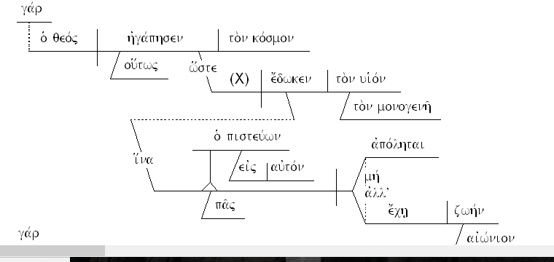
JOHN 3:16

Slide 23
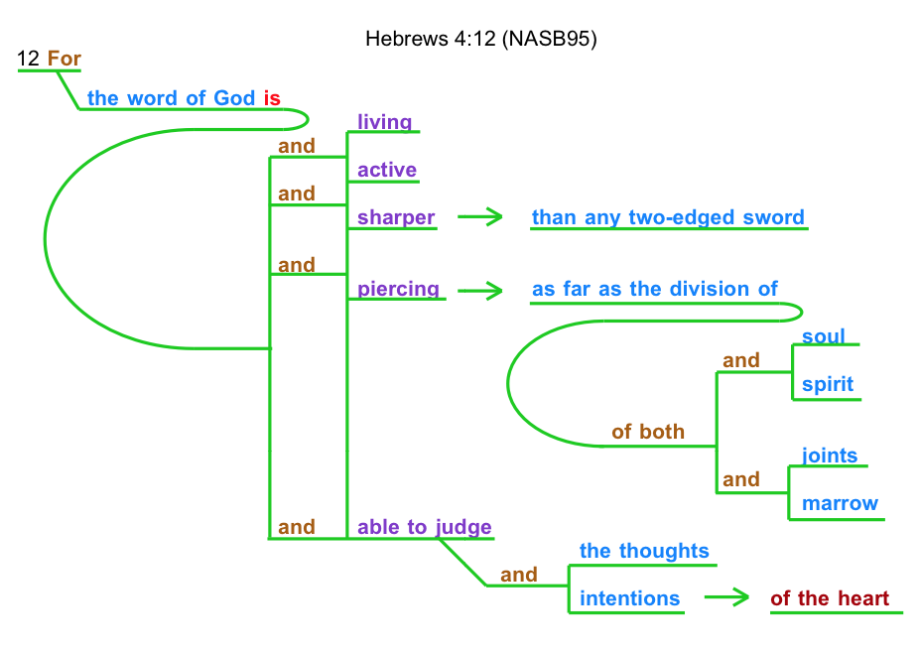
HEBREWS 4:12

Slide 24
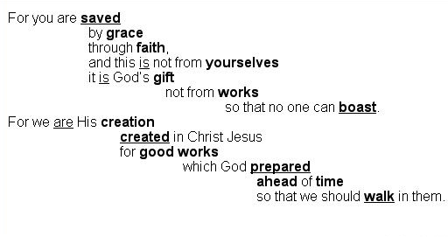
EPHESIANS 2:8-10

Slide 25
METICULOUSLY
ANALYZE
THE STRUCTURE
LOOK FOR:
1. CONJUNCTIONS
2. VERBS
3. REPEATED WORDS
4. KEY WORDS/ PHRASES
Matthew 6: 25-34

Slide 26
METICULOUSLY
ANALYZE
THE STRUCTURE
LOOK FOR:
1. CONJUNCTIONS
2. VERBS
3. REPEATED WORDS
4. KEY WORDS/ PHRASES
Matthew 6: 25-34

Slide 27
25 “Therefore I tell you, do not be anxious about your life, what you will eat or what you will drink, nor about your body, what you will put on. Is not life more than food, and the body more than clothing? 26 Look at the birds of the air: they neither sow nor reap nor gather into barns, and yet your heavenly Father feeds them. Are you not of more value than they? 27 And which of you by being anxious can add a single hour to his span of life? 28 And why are you anxious about clothing? Consider the lilies of the field, how they grow: they neither toil nor spin, 29 yet I tell you, even Solomon in all his glory was not arrayed like one of these. 30 But if God so clothes the grass of the field, which today is alive and tomorrow is thrown into the oven, will he not much more clothe you, O you of little faith? 31Therefore do not be anxious, saying, ‘What shall we eat?’ or ‘What shall we drink?’ or ‘What shall we wear?’ 32 For the Gentiles seek after all these things, and your heavenly Father knows that you need them all. 33 But seek first the kingdom of God and his righteousness, and all these things will be added to you.
34 “Therefore do not be anxious about tomorrow, for tomorrow will be anxious for itself. Sufficient for the day is its own trouble.

Slide 28





25 “Therefore I tell you, do not be anxious about your life, what you will eat or what you will drink, nor about your body, what you will put on. Is not life more than food, and the body more than clothing? 26 Look at the birds of the air: they neither sow nor reap nor gather into barns, and yet your heavenly Father feeds them. Are you not of more value than they? 27 And which of you by being anxious can add a single hour to his span of life? 28 And why are you anxious about clothing? Consider the lilies of the field, how they grow: they neither toil nor spin, 29 yet I tell you, even Solomon in all his glory was not arrayed like one of these. 30 But if God so clothes the grass of the field, which today is alive and tomorrow is thrown into the oven, will he not much more clothe you, O you of little faith? 31Therefore do not be anxious, saying, ‘What shall we eat?’ or ‘What shall we drink?’ or ‘What shall we wear?’ 32 For the Gentiles seek after all these things, and your heavenly Father knows that you need them all. 33 But seek first the kingdom of God and his righteousness, and all these things will be added to you.
34 “Therefore do not be anxious about tomorrow, for tomorrow will be anxious for itself. Sufficient for the day is its own trouble. TRANSITIONS / KEY CONJUNCTIONS

Slide 29





25 “Therefore I tell you, do not be anxious about your life, what you will eat or what you will drink, nor about your body, what you will put on. Is not life more than food, and the body more than clothing? 26 Look at the birds of the air: they neither sow nor reap nor gather into barns, and yet your heavenly Father feeds them. Are you not of more value than they? 27 And which of you by being anxious can add a single hour to his span of life? 28 And why are you anxious about clothing? Consider the lilies of the field, how they grow: they neither toil nor spin, 29 yet I tell you, even Solomon in all his glory was not arrayed like one of these. 30 But if God so clothes the grass of the field, which today is alive and tomorrow is thrown into the oven, will he not much more clothe you, O you of little faith? 31Therefore do not be anxious, saying, ‘What shall we eat?’ or ‘What shall we drink?’ or ‘What shall we wear?’ 32 For the Gentiles seek after all these things, and your heavenly Father knows that you need them all. 33 But seek first the kingdom of God and his righteousness, and all these things will be added to you.
34 “Therefore do not be anxious about tomorrow, for tomorrow will be anxious for itself. Sufficient for the day is its own trouble. VERBS / IMPERATIVES

Slide 30

25 “Therefore I tell you, do not be anxious about your life, what you will eat or what you will drink, nor about your body, what you will put on. Is not life more than food, and the body more than clothing? 26 Look at the birds of the air: they neither sow nor reap nor gather into barns, and yet your heavenly Father feeds them. Are you not of more value than they? 27 And which of you by being anxious can add a single hour to his span of life? 28 And why are you anxious about clothing? Consider the lilies of the field, how they grow: they neither toil nor spin, 29 yet I tell you, even Solomon in all his glory was not arrayed like one of these. 30 But if God so clothes the grass of the field, which today is alive and tomorrow is thrown into the oven, will he not much more clothe you, O you of little faith? 31Therefore do not be anxious, saying, ‘What shall we eat?’ or ‘What shall we drink?’ or ‘What shall we wear?’ 32 For the Gentiles seek after all these things, and your heavenly Father knows that you need them all. 33 But seek first the kingdom of God and his righteousness, and all these things will be added to you.
34 “Therefore do not be anxious about tomorrow, for tomorrow will be anxious for itself. Sufficient for the day is its own trouble. VERBS / MAIN IDEA

Slide 31






25 “Therefore I tell you, do not be anxious about your life, what you will eat or what you will drink, nor about your body, what you will put on. Is not life more than food, and the body more than clothing? 26 Look at the birds of the air: they neither sow nor reap nor gather into barns, and yet your heavenly Father feeds them. Are you not of more value than they? 27 And which of you by being anxious can add a single hour to his span of life? 28 And why are you anxious about clothing? Consider the lilies of the field, how they grow: they neither toil nor spin, 29 yet I tell you, even Solomon in all his glory was not arrayed like one of these. 30 But if God so clothes the grass of the field, which today is alive and tomorrow is thrown into the oven, will he not much more clothe you, O you of little faith? 31Therefore do not be anxious, saying, ‘What shall we eat?’ or ‘What shall we drink?’ or ‘What shall we wear?’ 32 For the Gentiles seek after all these things, and your heavenly Father knows that you need them all. 33 But seek first the kingdom of God and his righteousness, and all these things will be added to you.
34 “Therefore do not be anxious about tomorrow, for tomorrow will be anxious for itself. Sufficient for the day is its own trouble. μεριμνάω merimnaó

Slide 32
DETERMINING THE OUTLINE
Matthew 6: 25-34

Slide 33
UTILIZING A
PLURAL NOUN PROPOSITION
(what you propose to say)

Slide 34
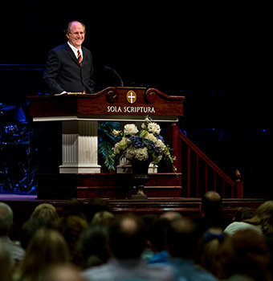
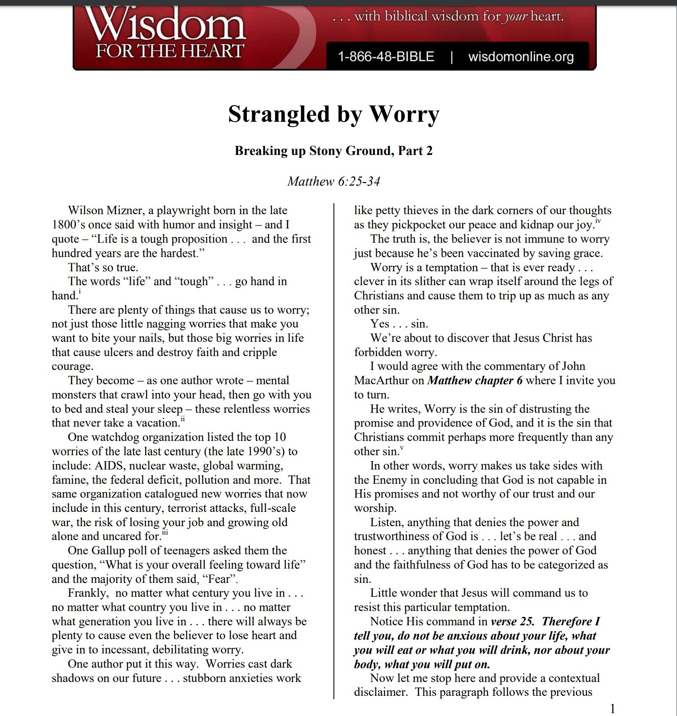


Slide 35
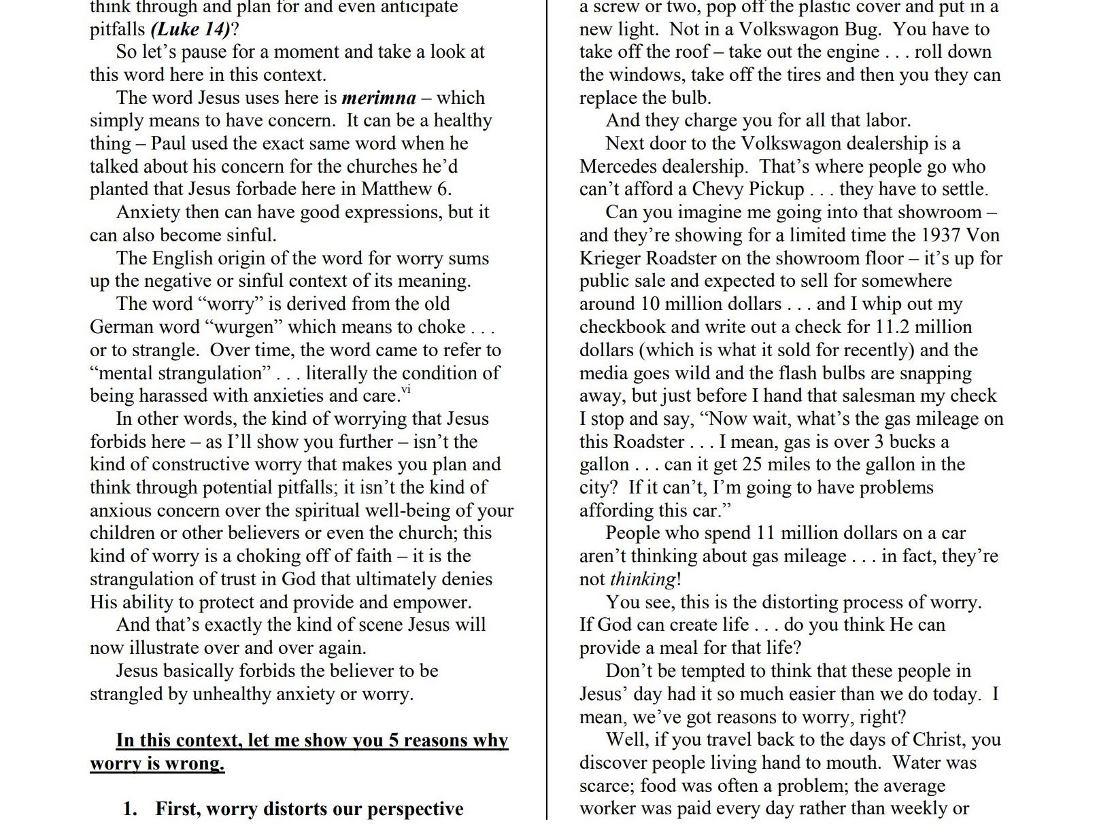


Slide 36



Slide 37
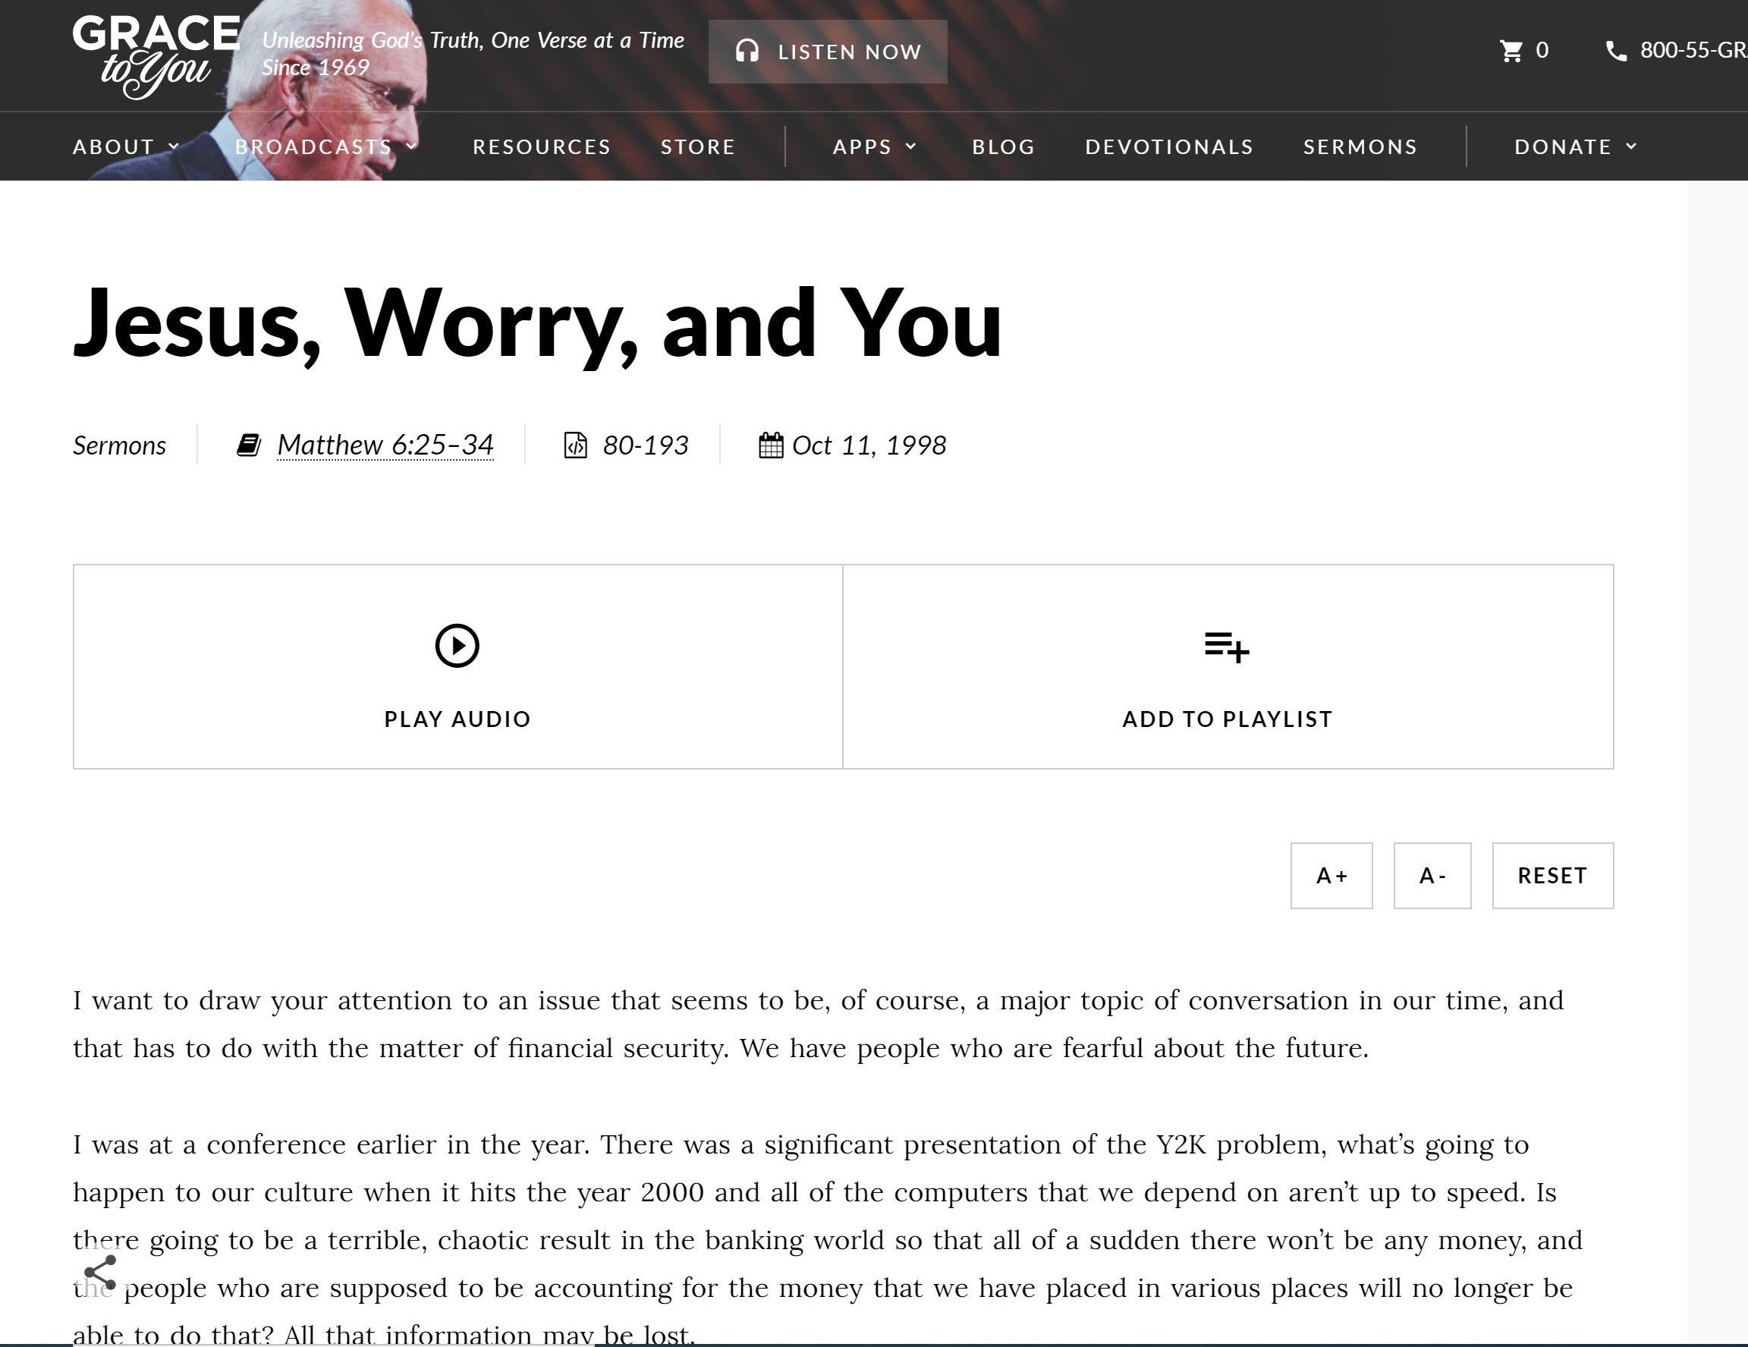

Slide 38
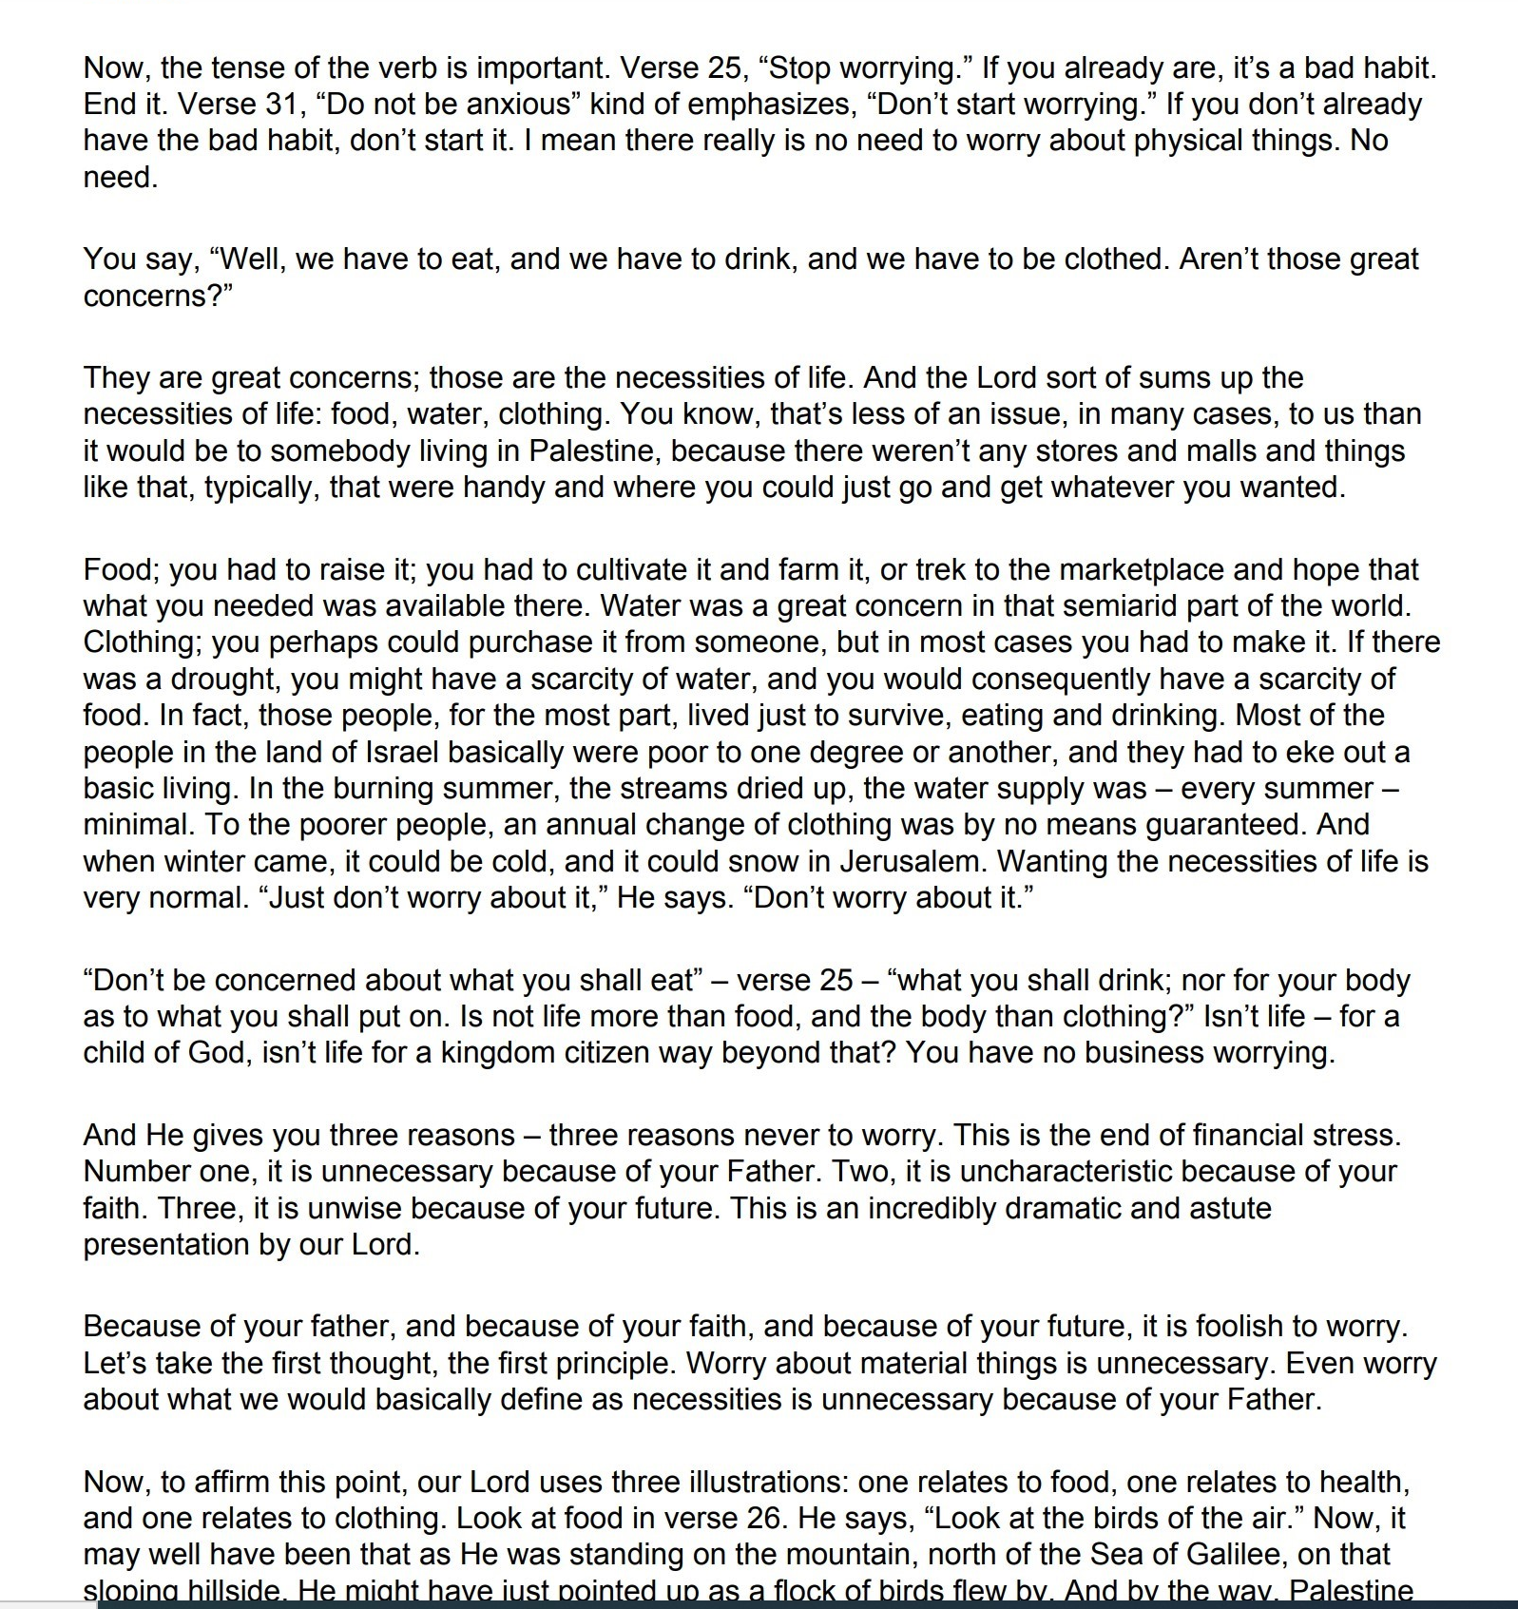




Slide 39
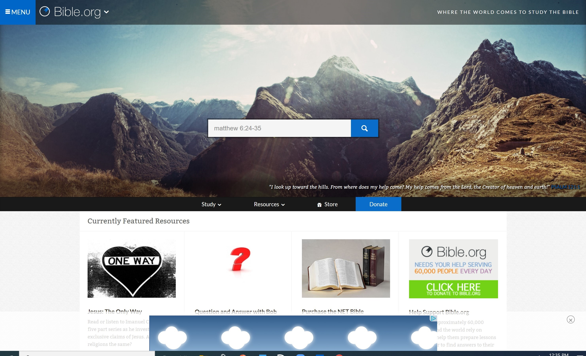


Slide 40








Consider The Lilies: Trusting God Instead of Controlling God (Matthew 6:25-34)
Sermon Outline by David Anderson at bible.org
BACKGROUND / REVIEW OF CONTEXT:
a. Two kinds of treasures.
b. Two kinds of eyes.
c. Two kinds of masters.
d. Main Point: Jesus needs to be prioritized and valued above all else.
e. The result of proper priorities, the result of a single-mindedness to Christ, the result of all this is freedom from anxiety and worry.
INTRODUCTION
a. One main point: Don’t be anxious, but trust the Lord.
b. This entire section has to do with “worry.”
i. It is mentioned 6 times.
ii. The word is actually ties to insomnia.
c. “Therefore I tell you”
i. This section is tied to the previous section on money.
ii. This is the result of the previous section.
1. The result of seeking worldly treasure.
2. The result of having your vision blinded by money.
3. The result of serving the god of Mammon…is worry and anxiety.
4. The result of rejecting the idol of Mammon and trusting in a better Master…is peace.
iii. “Therefore” If we haven’t come to grips with the previous section, we are hopeless when we get to this section.
d. “don’t be anxious about your life…”
i. Jesus lays down the main point and principle: Don’t worry about your life.

Slide 41

Consider The Lilies: Trusting God Instead of Controlling God (Matthew 6:25-34)
Sermon Outline by David Anderson at bible.org
BACKGROUND / REVIEW OF CONTEXT:
a. Two kinds of treasures.
b. Two kinds of eyes.
c. Two kinds of masters.
d. Main Point: Jesus needs to be prioritized and valued above all else.
e. The result of proper priorities, the result of a single-mindedness to Christ, the result of all this is freedom from anxiety and worry.
INTRODUCTION
a. One main point: Don’t be anxious, but trust the Lord.
b. This entire section has to do with “worry.”
i. It is mentioned 6 times.
ii. The word is actually ties to insomnia.
c. “Therefore I tell you”
i. This section is tied to the previous section on money.
ii. This is the result of the previous section.
1. The result of seeking worldly treasure.
2. The result of having your vision blinded by money.
3. The result of serving the god of Mammon…is worry and anxiety.
4. The result of rejecting the idol of Mammon and trusting in a better Master…is peace.
iii. “Therefore” If we haven’t come to grips with the previous section, we are hopeless when we get to this section.
d. “don’t be anxious about your life…”
i. Jesus lays down the main point and principle: Don’t worry about your life.

Slide 42

Consider The Lilies: Trusting God Instead of Controlling God (Matthew 6:25-34)
Sermon Outline by David Anderson at bible.org
BACKGROUND / REVIEW OF CONTEXT:
a. Two kinds of treasures.
b. Two kinds of eyes.
c. Two kinds of masters.
d. Main Point: Jesus needs to be prioritized and valued above all else.
e. The result of proper priorities, the result of a single-mindedness to Christ, the result of all this is freedom from anxiety and worry.
INTRODUCTION
a. One main point: Don’t be anxious, but trust the Lord.
b. This entire section has to do with “worry.”
i. It is mentioned 6 times.
ii. The word is actually ties to insomnia.
c. “Therefore I tell you”
i. This section is tied to the previous section on money.
ii. This is the result of the previous section.
1. The result of seeking worldly treasure.
2. The result of having your vision blinded by money.
3. The result of serving the god of Mammon…is worry and anxiety.
4. The result of rejecting the idol of Mammon and trusting in a better Master…is peace.
iii. “Therefore” If we haven’t come to grips with the previous section, we are hopeless when we get to this section.
d. “don’t be anxious about your life…”
i. Jesus lays down the main point and principle: Don’t worry about your life.

Slide 43

ii. Jesus is warning against the same sin as the pervious section: dependence on earthly things.
e. The Lord rebukes worry:
i. In the same way that it’s impossible to serve Money and God at the same time, it’s impossible to worry and trust God at the same time.
ii. If you are worrying, you are not trusting.
iii. The person who worries is basically sinning the sin of unbelief.
iv. The person who worries is essentially saying, “God, I don’t trust that you are competent or have my best interests in mind.”
v. “I know better than you do.” Or, “I’m not totally convinced that you know best.”
vi. And so instead of trusting God, we try to control Him.
vii. We will either try to control God or Trust God, but we can’t do both.
I. THE REALM OF ANXIETY, 6:25-29 (Four areas of worry).
Anxiety about the body.
1. We worry over the length of our lives and the state of our health.
2. We are a culture obsessed with body image. Body perfection.
3. Our body is a temple—not a god.
Anxiety about food.
1. We worry over what we will eat and drink, over diets and fats and carbohydrates.
2. Some of this is good. Because we are surrounded by so much junk and processed oil. We live in Fast-food nation.
3. But the opposite is true too! It’s possible for many people today to obsess over organic. Losing sleep over anything that might taint the body!
Anxiety about clothes.
1. Style, fashion, and design are overrated, are frivolous at best in the long-term, and vain at worst.

Slide 44



ii. Jesus is warning against the same sin as the pervious section: dependence on earthly things.
e. The Lord rebukes worry:
i. In the same way that it’s impossible to serve Money and God at the same time, it’s impossible to worry and trust God at the same time.
ii. If you are worrying, you are not trusting.
iii. The person who worries is basically sinning the sin of unbelief.
iv. The person who worries is essentially saying, “God, I don’t trust that you are competent or have my best interests in mind.”
v. “I know better than you do.” Or, “I’m not totally convinced that you know best.”
vi. And so instead of trusting God, we try to control Him.
vii. We will either try to control God or Trust God, but we can’t do both.
I. THE REALM OF ANXIETY, 6:25-29 (Four areas of worry).
Anxiety about the body.
1. We worry over the length of our lives and the state of our health.
2. We are a culture obsessed with body image. Body perfection.
3. Our body is a temple—not a god.
Anxiety about food.
1. We worry over what we will eat and drink, over diets and fats and carbohydrates.
2. Some of this is good. Because we are surrounded by so much junk and processed oil. We live in Fast-food nation.
3. But the opposite is true too! It’s possible for many people today to obsess over organic. Losing sleep over anything that might taint the body!
Anxiety about clothes.
1. Style, fashion, and design are overrated, are frivolous at best in the long-term, and vain at worst.

Slide 45


2. We worry about being in fashion or out of fashion
Anxiety about the length of life
1. Harvard prof. Daniel Gilbert: “The human is the only animal that ….thinks about the future”
2. We think about the future, but WHAT do we think about the future? Is it a future where God is in control? On the throne? Sovereign? Or is it a future where I am in control?
3. Is it possible we worry because we try to control God instead of trust God?
Main Point of this section: God abundantly takes care of creation, how much more His disciples.
II. THE ROOT OF ANXIETY, 6:30
a. What is the root of anxiety?
i. “But if God so clothes the grass of the field, which today is alive and tomorrow is thrown into the oven, will he not much more clothe you, O you of little faith?”
ii. The root of anxiety is unbelief. Period.
1. Anxiety is connected to “little faith.”
2. It is connected with faith (trust).
vi. You can’t serve God and Money at the same time—it’s impossible.
vii. And you can’t Trust God and Worry at the same time—it’s impossible.
b. There is a connection between idolatry and Anxiety.
i. When we worry, we replace God with a lesser God. An unstable god. A capricious god.
ii. Idolatry is way to understand all sin.
c. Identify your idols.
i. Idolatry is not merely bowing down to a statue or a piece of wood.
ii. When you look to some created thing to give you what only God can give you that is idolatry. An idol is anything in your life that is so central to your life that you can’t have a meaningful life if you lose it.” (Keller)

Slide 46

d. The root of anxiety comes from unbelief about God.
i. You are trusting something else, other than God.
III. THE REMEDY FOR ANXIETY, 6:30-34
a. Don’t be anxious--
“Therefore do not be anxious, saying, ‘What shall we eat?’ or ‘What shall we drink?’ or ‘What shall we wear?’ 32 For the Gentiles seek after all these things, and your heavenly Father knows that you need them all.”
b. The Gentiles seek after these things…
i. The “idolaters” seek after these things.
ii. The Gentiles give their time and energy and worry about these things… It makes sense that unbelievers are anxious, but not you!
c. The Remedy: “But seek first the kingdom of God and his righteousness, and all these things will be added to you.”
i. The remedy is to think about and be preoccupied with the coming Kingdom.
ii. “and His righteousness”
1. This does not mean justification.
2. It is a practical righteousness that is basically a conformity and submission to the will of God.
iii. The results…
1. The result of seeking worldly treasure, blinded by money, serving the god of Mammon…is worry and anxiety.
2. The result of seeking treasures in heaven is having a clear vision of eternity…is peace and more simplicity
“Therefore do not be anxious about tomorrow, for tomorrow will be anxious for itself. Sufficient for the day is its own trouble.” Don’t be anxious—trust the Lord.

Slide 47





Consider The Lilies: Trusting God Instead of Controlling God (Matthew 6:25-34)
Sermon Outline by David Anderson at bible.org
BACKGROUND / REVIEW OF CONTEXT:
a. Two kinds of treasures.
b. Two kinds of eyes.
c. Two kinds of masters.
d. Main Point: Jesus needs to be prioritized and valued above all else.
e. The result of proper priorities, the result of a single-mindedness to Christ, the result of all this is freedom from anxiety and worry.
INTRODUCTION
a. One main point: Don’t be anxious, but trust the Lord.
b. This entire section has to do with “worry.”
i. It is mentioned 6 times.
ii. The word is actually ties to insomnia.
c. “Therefore I tell you”
i. This section is tied to the previous section on money.
ii. This is the result of the previous section.
1. The result of seeking worldly treasure.
2. The result of having your vision blinded by money.
3. The result of serving the god of Mammon…is worry and anxiety.
4. The result of rejecting the idol of Mammon and trusting in a better Master…is peace.
iii. “Therefore” If we haven’t come to grips with the previous section, we are hopeless when we get to this section.
d. “don’t be anxious about your life…”
i. Jesus lays down the main point and principle: Don’t worry about your life.

Slide 48
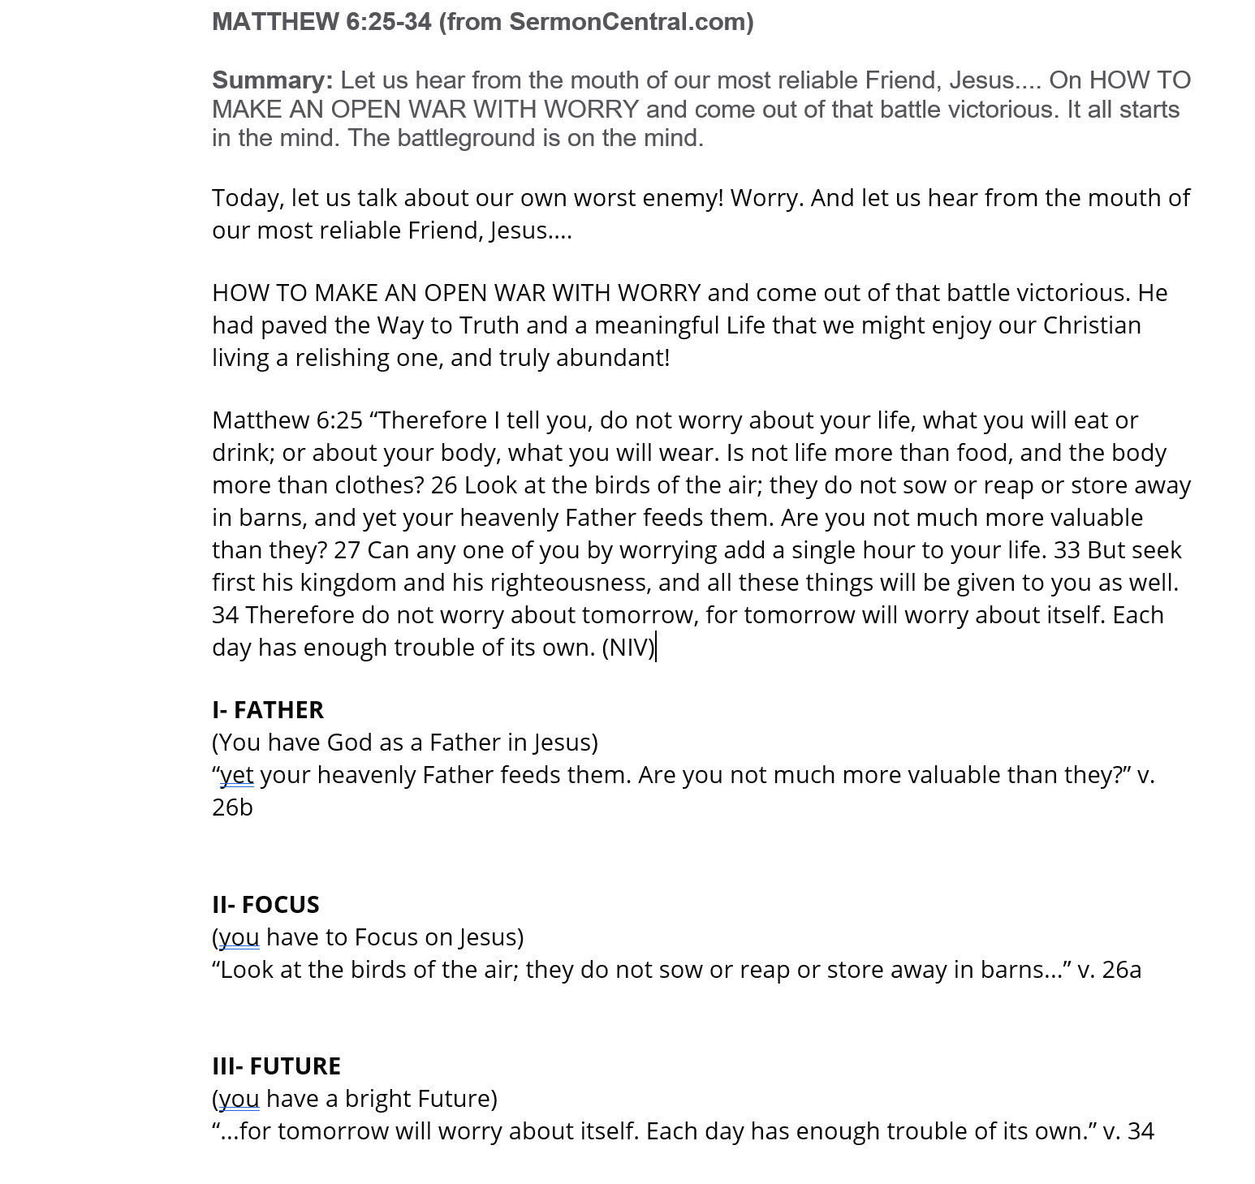


Slide 49




Slide 50




Slide 51




Slide 52














Slide 53







Slide 54








Slide 55
UTILIZING A
PLURAL NOUN PROPOSITION
GIVES STRUCTURE
AND LOGICAL DEVELOPMENT
TO THE SERMON.

Slide 56
UTILIZING A
PLURAL NOUN PROPOSITION
MAKES CRAFTING YOUR OUTLINE EASIER.

Slide 57

One way of organizing
accurate exegetical information
into a form that listeners
can readily comprehend.
CRAFTING, CONSTRUCTING, SHAPING

Slide 58

One way of organizing
accurate exegetical information
into a form that listeners
can readily comprehend.
HERMENEUTICS, LANGUAGES, SYNTAX…
THE WORK IN YOUR STUDY

Slide 59

One way of organizing
accurate exegetical information
into a form that listeners
can readily comprehend.
ORAL COMMUNICATION

Slide 60

One way of organizing
accurate exegetical information
into a form that listeners
can readily comprehend.
CLARITY, STRUCTURE, COHERENCE

Slide 61



CLARITY IS NOT THE SAME AS ACCURACY
Accuracy has to do with the biblical text.
Clarity has to do with communicating about that text

Slide 62
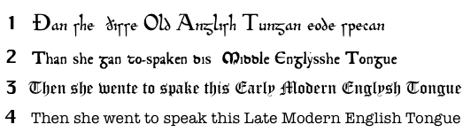
COMPREHENSION IS ESSENTIAL

Slide 63

One way of organizing
accurate exegetical information
into a form that listeners
can readily comprehend.
CLARITY, STRUCTURE, COHERENCE

Slide 64
One way of organizing
accurate exegetical information
into a form that listeners
can readily comprehend.
WHY? TO FACILITATE UNDERSTANDING
THE BIBLE + POINT TOWARDS OBEDIENCE.

Slide 65
Plural Noun
Proposition
IMPORTANCE OF PLURAL NOUN PROPOSITION

Slide 66
From text to sermon…
PLURAL NOUN PROPOSITION
DETERMINING THE OUTLINE
Ephesians 1:3-8

Slide 67



³ Blessed be the God and Father of our Lord Jesus Christ, who has blessed us in Christ with every spiritual blessing in the heavenly places,
⁴ even as he chose us in him before the foundation of the world, that we should be holy and blameless before him.
In love ⁵ he predestined us for adoption to himself as sons through Jesus Christ, according to the purpose of his will, ⁶ to the praise of his glorious grace, with which he has blessed us in the Beloved.
⁷ In him we have redemption through his blood,
the forgiveness of our trespasses, according to the riches of his grace, ⁸ which he lavished upon us, in all wisdom and insight

Slide 68






³ Blessed be the God and Father of our Lord Jesus Christ, who has blessed us in Christ with every spiritual blessing in the heavenly places,
⁴ even as he chose us in him before the foundation of the world, that we should be holy and blameless before him.
In love ⁵ he predestined us for adoption to himself as sons through Jesus Christ, according to the purpose of his will, ⁶ to the praise of his glorious grace, with which he has blessed us in the Beloved.
⁷ In him we have redemption through his blood,
the forgiveness of our trespasses, according to the riches of his grace, ⁸ which he lavished upon us, in all wisdom and insight

Slide 69

Ephesians 1:3-8
Key word in passage = blessing

Slide 70


Ephesians 1:3-8
Key word in passage = blessing
Proposition: Four of the blessings we have in Christ

Slide 71



Ephesians 1:3-8
Proposition: Four of the blessings we have in Christ
Our first blessing: we are chosen in Him (v.4)
Our second blessing: we are adopted in Him (vv. 5-6)
Our third blessing: we have redemption in Him (v.7a)
Our fourth blessing:we have forgiveness in Him (vv. 7b-8)

Slide 72




Ephesians 1:3-8
Proposition: Four of the blessings we have in Christ
Our first blessing: we are chosen in Him (v.4)
Our second blessing: we are adopted in Him (vv. 5-6)
Our third blessing: we have redemption in Him (v.7a)
Our fourth blessing:we have forgiveness in Him (vv. 7b-8)

Slide 73
Tell them the number of points in the sermon outline and use a noun (person, place, or thing) to describe the points.

Slide 74
“In this passage we will see three keys [number + a plural noun] . . .”
“Here the Apostle Paul gives us four steps [number + a plural noun] . . .”
“Jesus presents two warnings [number + a plural noun] . . .”

Slide 75
The proposition can be expressed in more than one way.

Slide 76

Statement: “In this passage we will examine four characteristics of a man of integrity that will help us understand what it means to be a man after God’s own heart.”
Question: “What are some reasons for trusting God when you’re in the midst of a trial? Here are three…”
Exhortation: “As we study this passage, commit yourself to following these four steps to resolving conflict in your marriage.”
Exclamation: “What a joy it is to contemplate the three proofs of God’s sovereignty that we find in this passage!”

Slide 77


Statement: “In this passage we will examine four characteristics of a man of integrity that will help us understand what it means to be a man after God’s own heart.”
Question: “What are some reasons for trusting God when you’re in the midst of a trial? Here are three…”
Exhortation: “As we study this passage, commit yourself to following these four steps to resolving conflict in your marriage.”
Exclamation: “What a joy it is to contemplate the three proofs of God’s sovereignty that we find in this passage!”

Slide 78

Statement: “In this passage we will examine four characteristics of a man of integrity that will help us understand what it means to be a man after God’s own heart.”
Question: “What are some reasons for trusting God when you’re in the midst of a trial? Here are three…”
Exhortation: “As we study this passage, commit yourself to following these four steps to resolving conflict in your marriage.”
Exclamation: “What a joy it is to contemplate the three proofs of God’s sovereignty that we find in this passage!”

Slide 79

Statement: “In this passage we will examine four characteristics of a man of integrity that will help us understand what it means to be a man after God’s own heart.”
Question: “What are some reasons for trusting God when you’re in the midst of a trial? Here are three…”
Exhortation: “As we study this passage, commit yourself to following these four steps to resolving conflict in your marriage.”
Exclamation: “What a joy it is to contemplate the three proofs of God’s sovereignty that we find in this passage!”

Slide 80

EXAMPLES OF GOOD OUTLINES
WITH PLURAL NOUN PROPOSITION

Slide 81
2024 Shepherds 360 National Conference
Building
Better Sermons

Slide 82
2024 Shepherds 360 National Conference
Structuring for
Clarity & Purpose

